Slide 1



Football Data Analysis: Key Success Factors and Business Insights
Unveiling the hidden insights of football through data analysis can lead to a deeper understanding of player performance, team dynamics, and ultimately, achieving greater success. This presentation explores key factors that drive success within football, leveraging data analysis to optimize strategies.
by Akanksha Vanse
Program: Data Science and ML with GenAI Advanced program
Enrolment No: EN12025082587

Slide 2

Business Objectives
1
Player Performance
2
Market Evaluation
Analyze metrics to identify top performers and areas for improvement.
Assessing player worth and negotiating optimal contracts based on their performance and market trends.
3
Team Dynamics
4
Game Influences
Compare team performance and understand the impact of attendance on results.
Examine referee impact and substitution patterns for strategic insights.

Slide 3

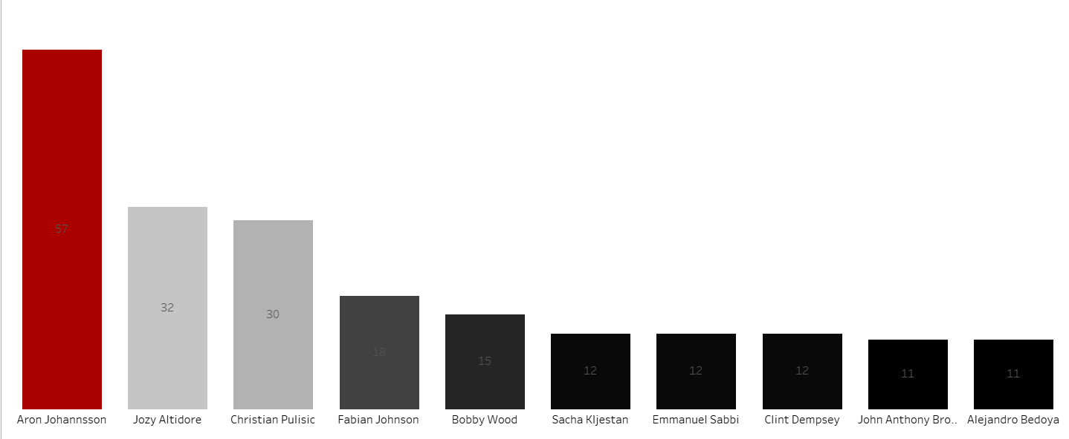
Performance Analysis
Metric
Key Findings
Top Scorer
Aron Johansson: 57 goals
Cards
Low cards for top scorers, high for defensive players
Seasonal Variation
Performance dropped in 2014 but got better after that.
Height 175

Slide 4
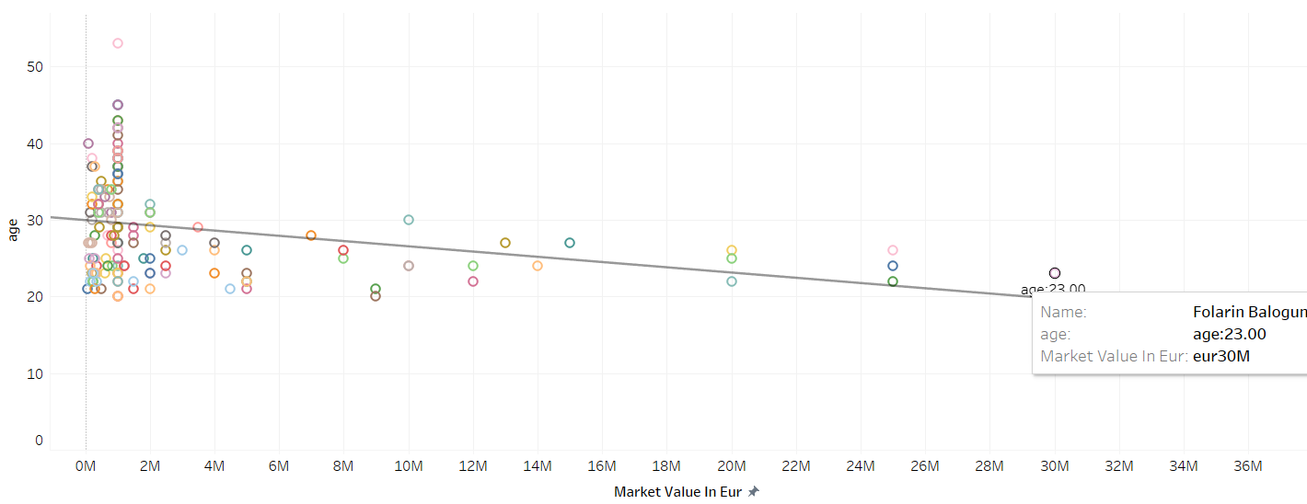
Player Profile & Market Value
Christian Pulisic
Folarin Balogun
Giovanni Reyna
Market Value: €25M
Market Value: €30M
Market Value: €25M
Key Stats: Significant contributions to team performance
Key Stats: Top market value player
Key Stats: High potential young talent

Slide 5
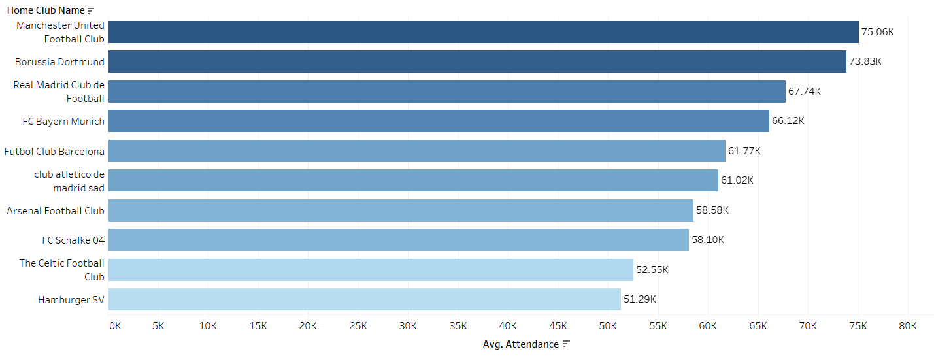
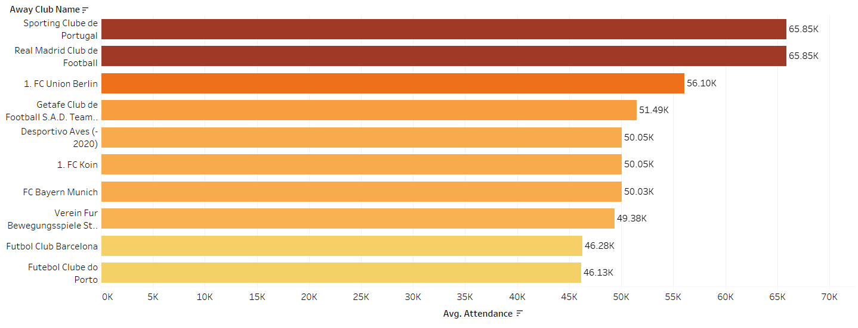

Team Comparison
Attendance:
Home club name: Manchester united football club has the highest attendance about 75.06 k
Goals:
Home club name: Borussia Verein fur Leibesubung 1900 has scored the highest goals in the season 2020.
Market Value:
Average market value of each player in the away club name( Sporting Club de portugal) is 25 M eur

Slide 6

Attendance & Stadium Analysis
Stadium
Average Attendance
Win Correlation
Old Trafford
75,062
High
Signal Iduna Park
73,830
Moderate

Slide 7
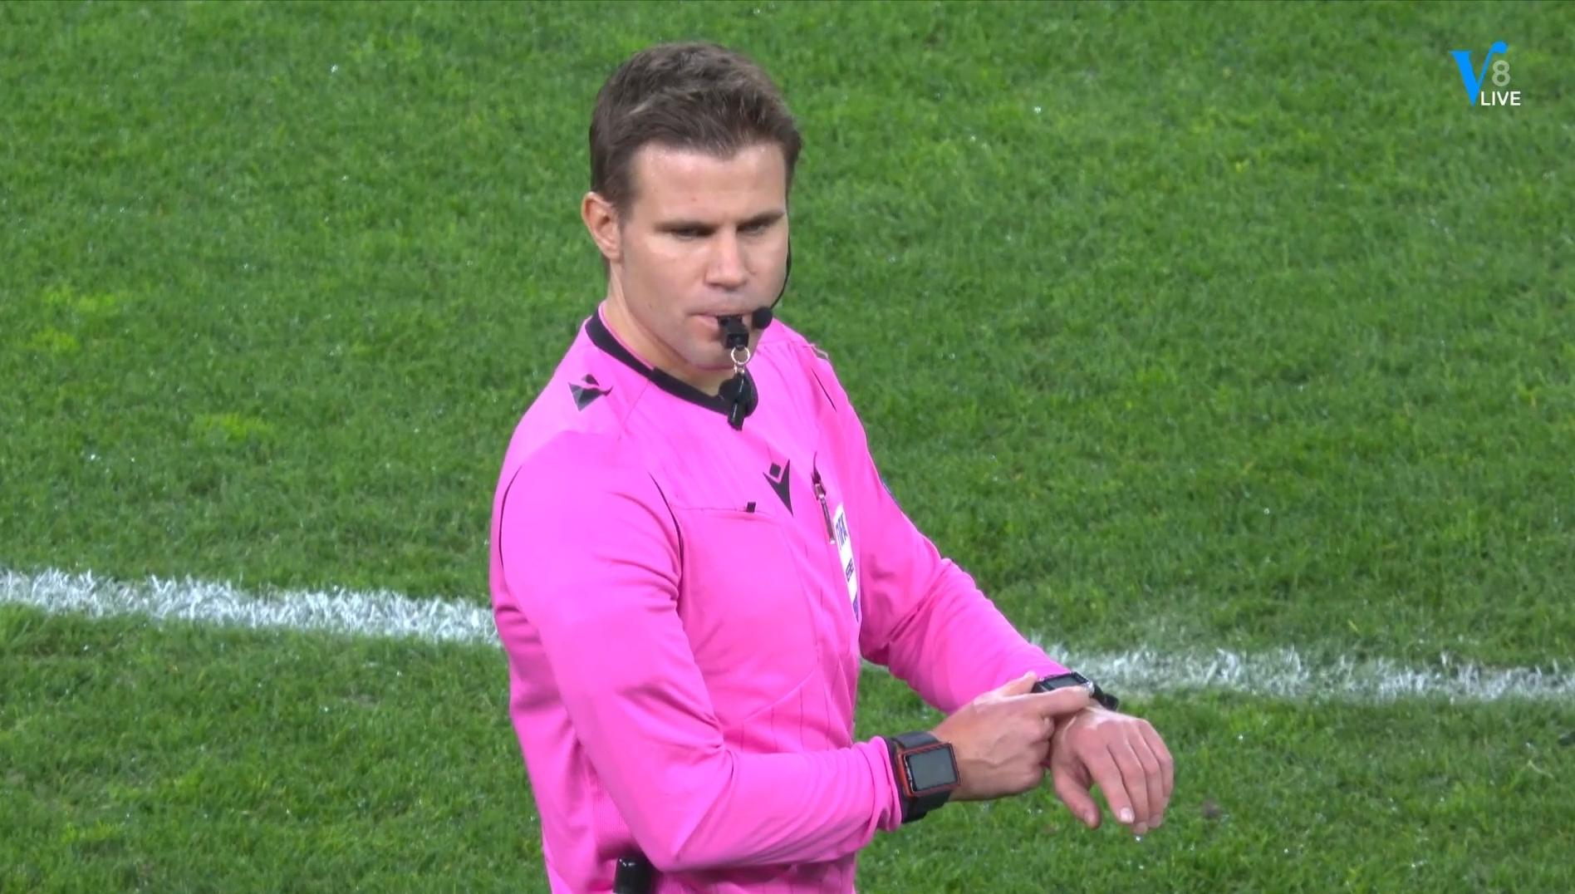

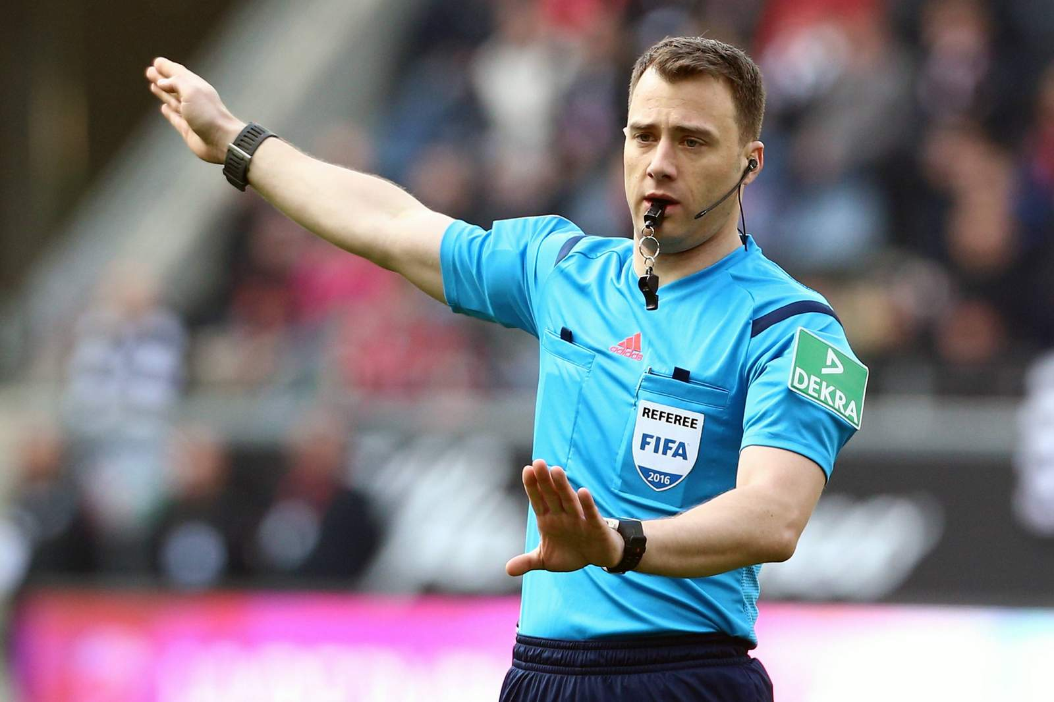
Referee Analysis & Impact of Cards
Dr. Felix Brych
Felix Zwayer
Card Impact
Matches Officiated: 60
Matches Officiated: 59
The analysis shows that giving out cards affects game outcomes in different ways.
Cards Issued: 10
Cards Issued: 14

Slide 8
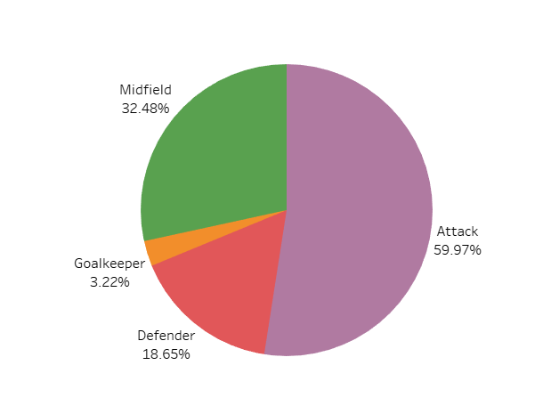
Substitution Patterns
1
Attackers
Most substituted due to high energy demands and tactical adjustments.
2
Midfielders
Second most substituted, essential for maintaining game dynamics and control.
3
Goalkeepers
Least substituted, reflecting the need for stability in this position.

Slide 9

Event Analysis
Event Type
Frequency
Key Findings
Substitutions
Most Frequent
Strategic importance in controlling game pace and influencing strategic outcomes.
Goals
Second Most Frequent
Central to game objectives, reflecting both offensive prowess and defensive vulnerabilities.
Cards
Least Frequent
Reflects team discipline, with a higher frequency indicating potential aggression or tactical fouls.

Slide 10
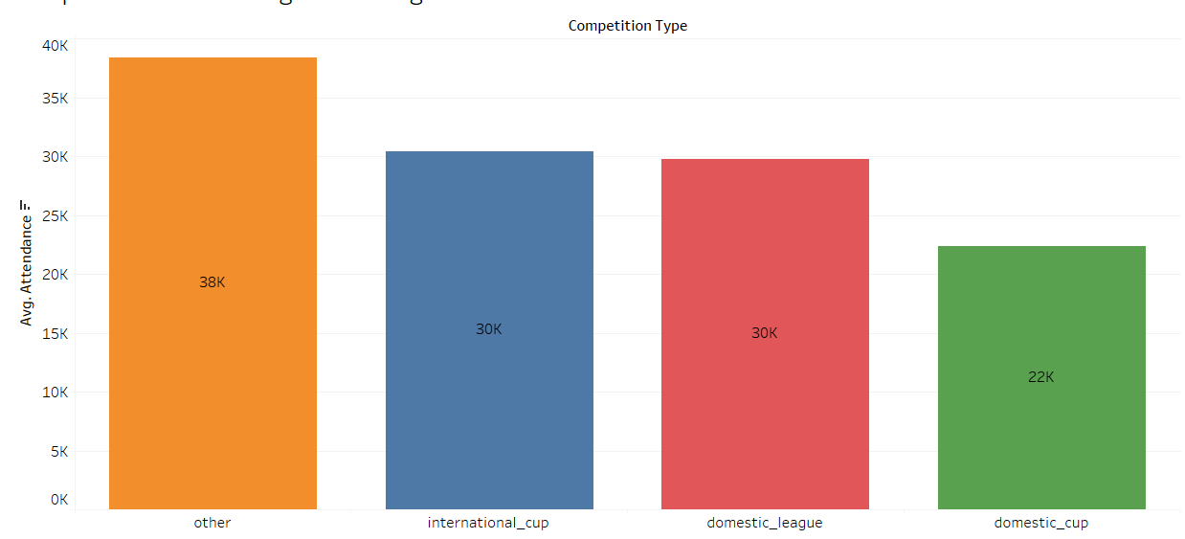
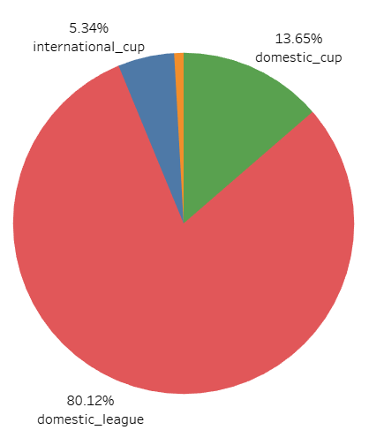
Competition
Analysis
Competition Type
Avg Attendance
Goal Distribution
Domestic League
Moderate
Majority of goals
Domestic Cup
Low
Competitive, fewer matches
International Cup
High
Defensive play

Slide 11

Business Conclusion
Performance Metrics
Market Values
Essential for identifying top talent and pinpointing areas for
team improvement.
Important for strategic player acquisitions and effective contract negotiations.
Attendance Impact
Game Management
Significant correlation with team performance, affecting revenue streams.
Referee decisions and substitution strategies play vital roles in outcomes.

Slide 12





Recommendations
Data-Driven Decisions
Value Optimization
Fan Engagement
Strategic Substitutions
Implement advanced analytics for player recruitment and strategic planning.
Use market value trends to inform contract negotiations and transfers.
Enhance stadium experience to boost attendance and team performance.
Develop data-backed substitution strategies for maximum impact.

Slide 13

Thank
You

